Slide 1

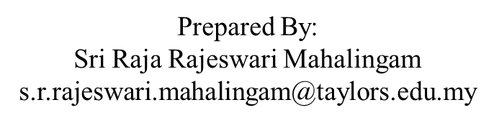
APPLICATION CHEMISTRY A2 LEVEL
ANALYTICAL CHEMISTRY CHAPTER 3:
PARTITION COEFFICIENT

Slide 2

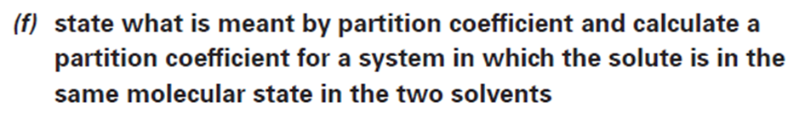

Slide 3
Liquid-liquid extraction
Liquid-liquid extraction is based on the transfer of a solute substance from one liquid phase into another liquid phase according to the solubility.
Extraction is used to separate a substance selectively from a mixture, or to remove unwanted impurities from a solution.
In the practical use, usually one phase is a water or water-based (aqueous) solution and the other an organic solvent which is immiscible with water.
The success of this method depends upon the difference in solubility of a compound in various solvents.
For a given compound, solubility differences between solvents is quantified as the “partition coefficient"

Slide 4
Partition Coefficient
In general, there are four different ways that molecules attract each other solubility).
These are:
ion-ion attractions
ion-dipole attractions
van der Waals’ (induced dipole) attractions
hydrogen bonding

Slide 5
Partition Coefficient
Solvents can, be listed according to their polarity.
Polar solvents are more likely to be able to dissolve ions, hydrogen bonded molecules and molecules with dipoles.
non-polar solvent are dissolve those solutes whose molecules are only attracted to each other by van der Waals’ forces

Slide 6
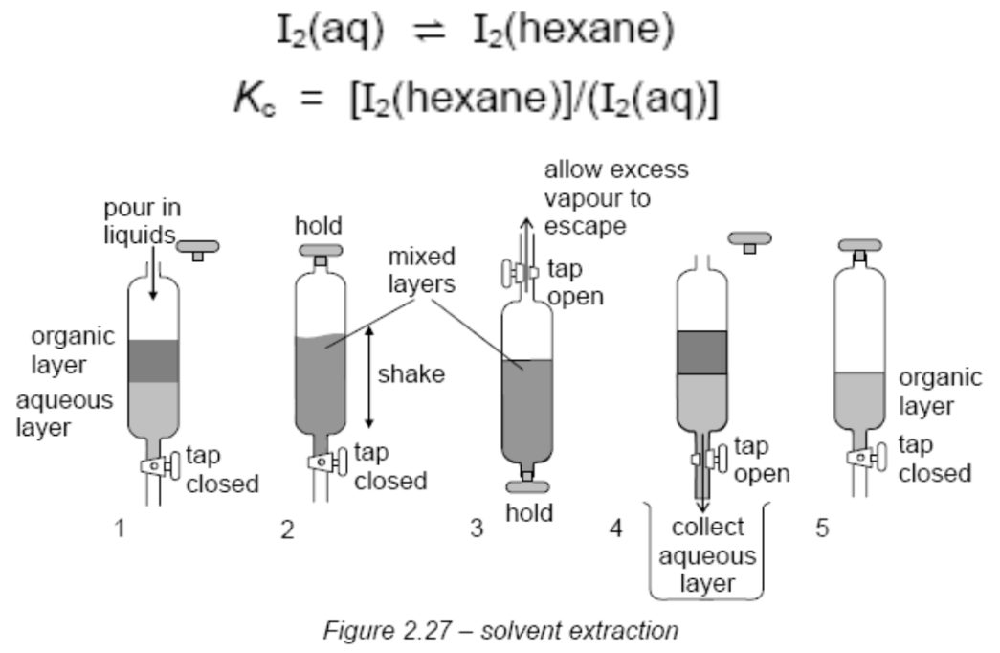
Example
Iodine is soluble in two immiscible solvents (e.g. water and hexane), its solubility is very unlikely to be the same in both solvents.
One solvent will be better at dissolving it than the other.
When some iodine crystals are shaken with a mixture of hexane and water until no further change takes place, two layers allowed to separate
The ratio of the concentrations of iodine in each layer is a constant.
This constant is the equilibrium constant for the change.

Slide 7
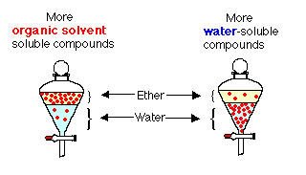
Partition Coefficient
When a compound is shaken in a separatory funnel with two immiscible solvents, the compound will distribute itself between the two solvents.
Normally one solvent is water and the other solvent is a water-immiscible organic solvent.
Most organic compounds are more soluble in organic solvents, while some organic compounds are more soluble in water.

Slide 8
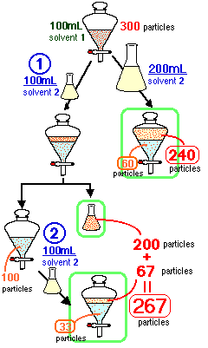
What happens if you extract twice with 100 mL of solvent ?
In this case, the amount of extraction solvent is the same volume as was used, but the total volume is divided into two portions and you extract with each.
An additional 67 particles are extracted with the second portion of extraction solvent (solvent₂).The total number of particles extracted from the first (200 particles) and second (67 particles) volumes of extraction solvent is 267.This is a greater number of particles than the single extraction (240 particles) using one 200 mL portion of solvent₂!
It is more efficient to carry out two extractions with 1/2 volume of extraction solvent than one large volume!

Slide 9
Partition Coefficient
Partition coefficient (Kpc):
The ratio of the concentrations of a solute in two different immiscible solvent when an equilibrium has been established.
Partition coefficients have no units.
Useful in working out how much solvent we need in order to extract a minimum amount of solute from one solvent into another.
Kpc = [x in organic solvent]
[x in water]

Slide 10
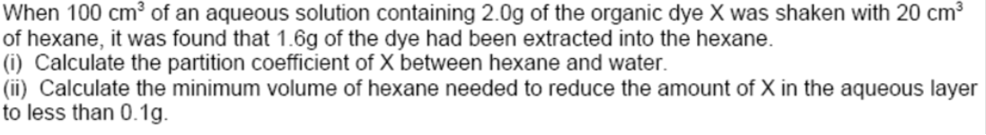
QUESTION 1

Slide 11
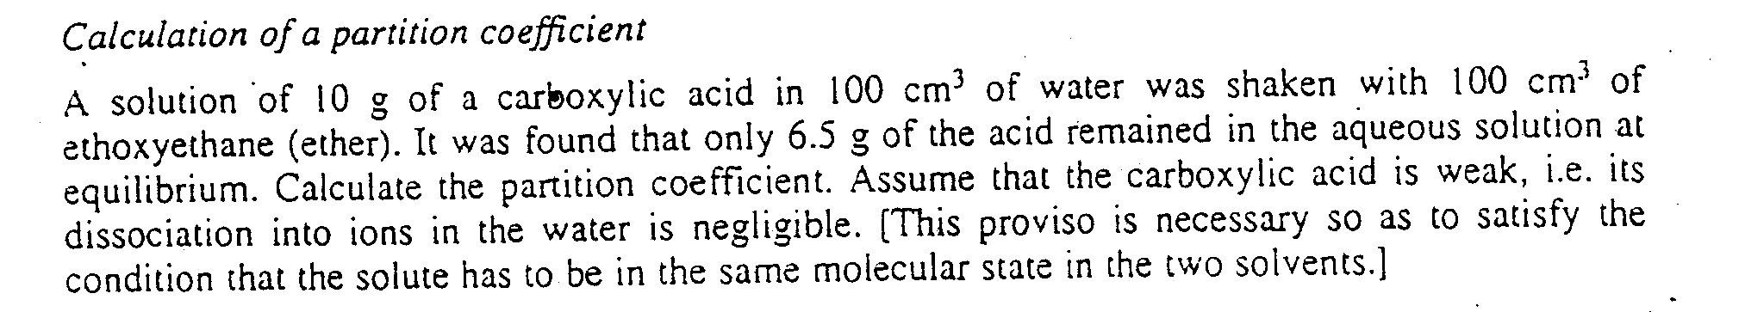
QUESTION 2

Slide 12
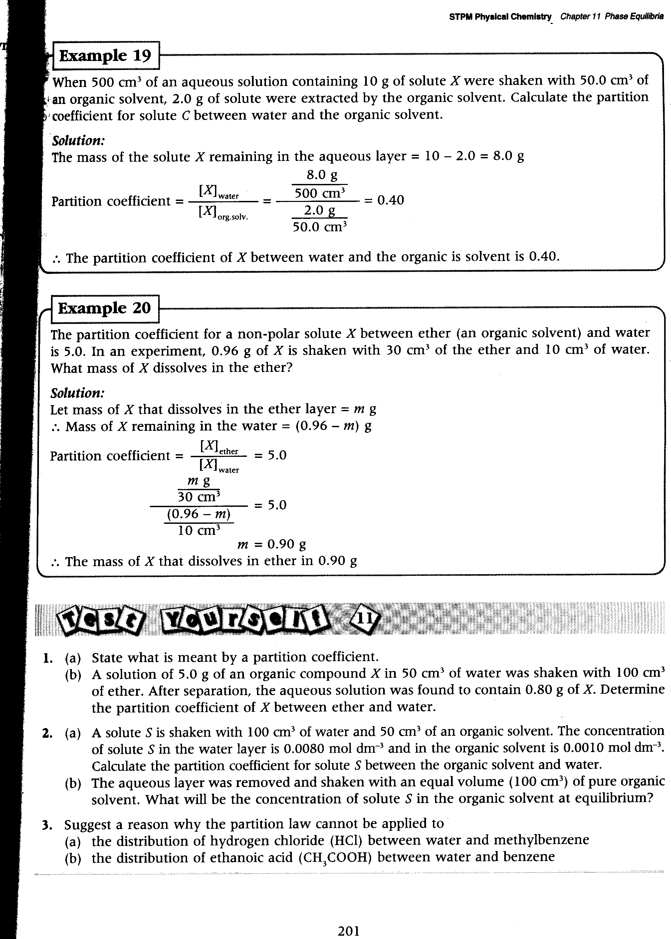
QUESTION 3

Slide 13
QUESTION 4

Slide 14
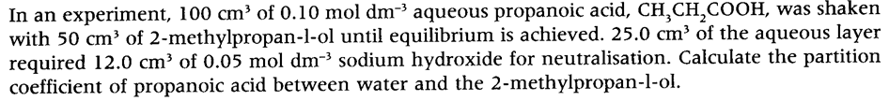
QUESTION 5

